Slide 1
Hey Emma, are you connected to the internet?
If you aren’t, the demo will be very boring…

Slide 2
mF2C

Slide 3
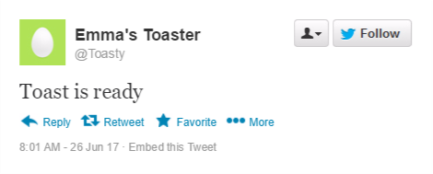
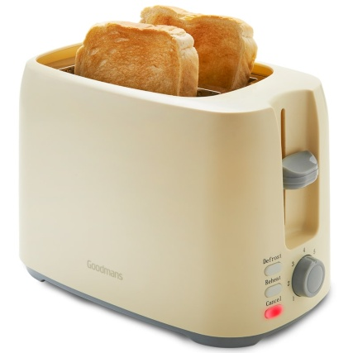
Internet of Things
Notes:
Or – does my toaster need to tweet?
But also citizen science (floods, radiation, air quality). Home monitoring: is my fridge door open? How many times did the cat use the catflap? What’s the temperature in my baby’s room? Do the plants need watering?
Home automation: turn the heating on before I get home. Water the plants/ feed the fish with my smartphone.
Dangers – difficult to adequately secure.

Slide 4
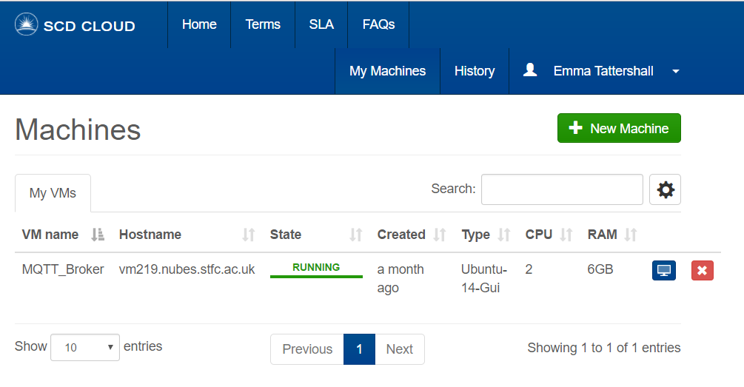
The Cloud
Notes:
Runs all the time. Can gather a lot of data together. Cloud systems are becoming very fashionable – Azure, etc. Great way to serve a website, monitor traffic, etc/

Slide 5



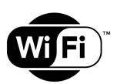



Notes:
Will show this slide again later. Start at bottom, work way back up

Slide 6
Edge devices: Arduino
Notes:
mF2C terminology: edge devices
No operating system, but easy to upload programs from computer
X inputs, X outputs – so can read from up to X sensors and light up up to X LEDS.
Setup loop, then loop forever
Could do same with much cheaper Arduino micro.
Can communicate via Bluetooth (if we wire up an extra little chip, or via serial cable)

Slide 7
Smart Agents: Raspberry Pi
Notes:
Cheap (~£30), off the shelf hardware with builtin Bluetooth, wifi, wired internet. Lots of operating system varients, but commonly use Raspbian (based on debian)

Slide 8
Protocol: MQTT
Notes:
Protocols – agreed upon message of communication.
Humans use them.
Hello
Hello
How are you?
Good. Yourself?
Fine, thanks.
And now we can talk.
British people have an optional extra element – believed by some to be an authentication step.
Bit windy out, isn’t it?
Tried to make my own protocol. Started by formatting messages as <source|destination|payload>. Then added escaping. Then realised that I needed to add more elements… and encrypt them …. Etcetera.
Since then, have realised that this is not a new problem, and have ceased reinventing the wheel.
Use MQTT, internet of things message broker. Lightweight, and fairly easy to use, if you can get past the sheer number of broker options out there.
Works by subscription/ publication: subscribe to test/#

Slide 9
Frontend: Flask
Notes:
Simple python webapp software. Can use to create/serve an interactive website.

Slide 10
Notes:
Here it is again.

Slide 11
The experiment: Sensors
Notes:
Circuit diagrams, photos, ranges. This is Mee-Mee’s bit; let’s have several slides.

Slide 12
Live website demo
Notes:
Switch onto internet, make sure connected to the internet

Slide 13
Results
Pretty graphs of Wednesday/Thursday’s sensor readings.
Notes:
Results for the day.

Slide 14
Conclusion
Is it useful? Fun at home (cat monitor, plant waterer)
Investment, research area.
Security is difficult to get right. Devices have little memory and is difficult to store and transmit long cryptographic keys.
Citizen science: Geiger counters deployed after Hiroshima, air quality monitors in London, flood monitoring. Often require little power.
Low powered wifi networks available for IoT devices.
Wearables, etc.

